Slide 1


TODO
2019 Juniper & Comcast
Kurt Sun; Bo Cheng; Litong Shen
Santa Clara University

Slide 2


The Trend
SDN has played a significant role in IT
HOMELAND SECURITY
Notes:
Modern information technology develops rapidly nowadays;
Software Defined Network plays a important role in
several new technologies and application such as ….(above)

Slide 3

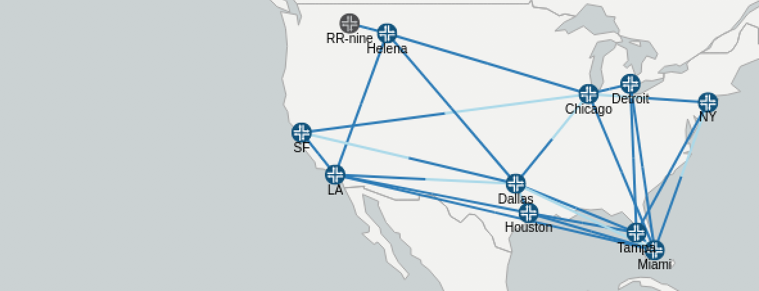
The Problem
When transport infrastructure is highly unstable
Links occasionally fail
Despite long emails and frustrating calls, your team has not been able to resolve the issues with the local providers

Slide 4


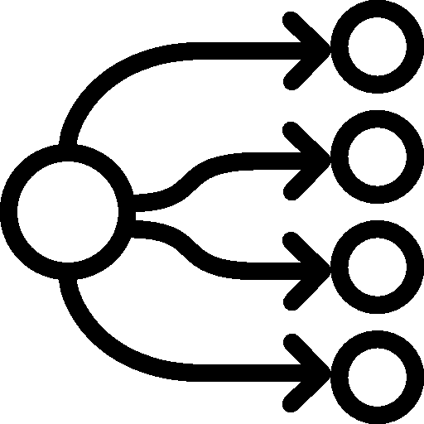

The Solution
Our solutions aim at supporting reliable service, on-demand deployment, timesaving configuration and profitable models based on the algorithms.
Flexible Rerouting
Tiered Paths
Redundant Paths
Optimized Links
Notes:
Elastic resources: no risk in under-provisioning, prevents underutilization
We want keep our customers by providing reliable service
We want automate things to save the tedious manual time
We want to provide different solutions to draw more revenues
With the help from Juniper NorthStar Controller, job becomes easier and life is getting better

Slide 5


Flexible Rerouting
Event Trigger
Get Link Metrics
Calculate Optimum LSP
Update LSP in NorthStar
Update
Log File
Solved Issues:
Link Failure Events
Traffic Over Pre-defined Threshold
Log History for Future Prediction

Slide 6
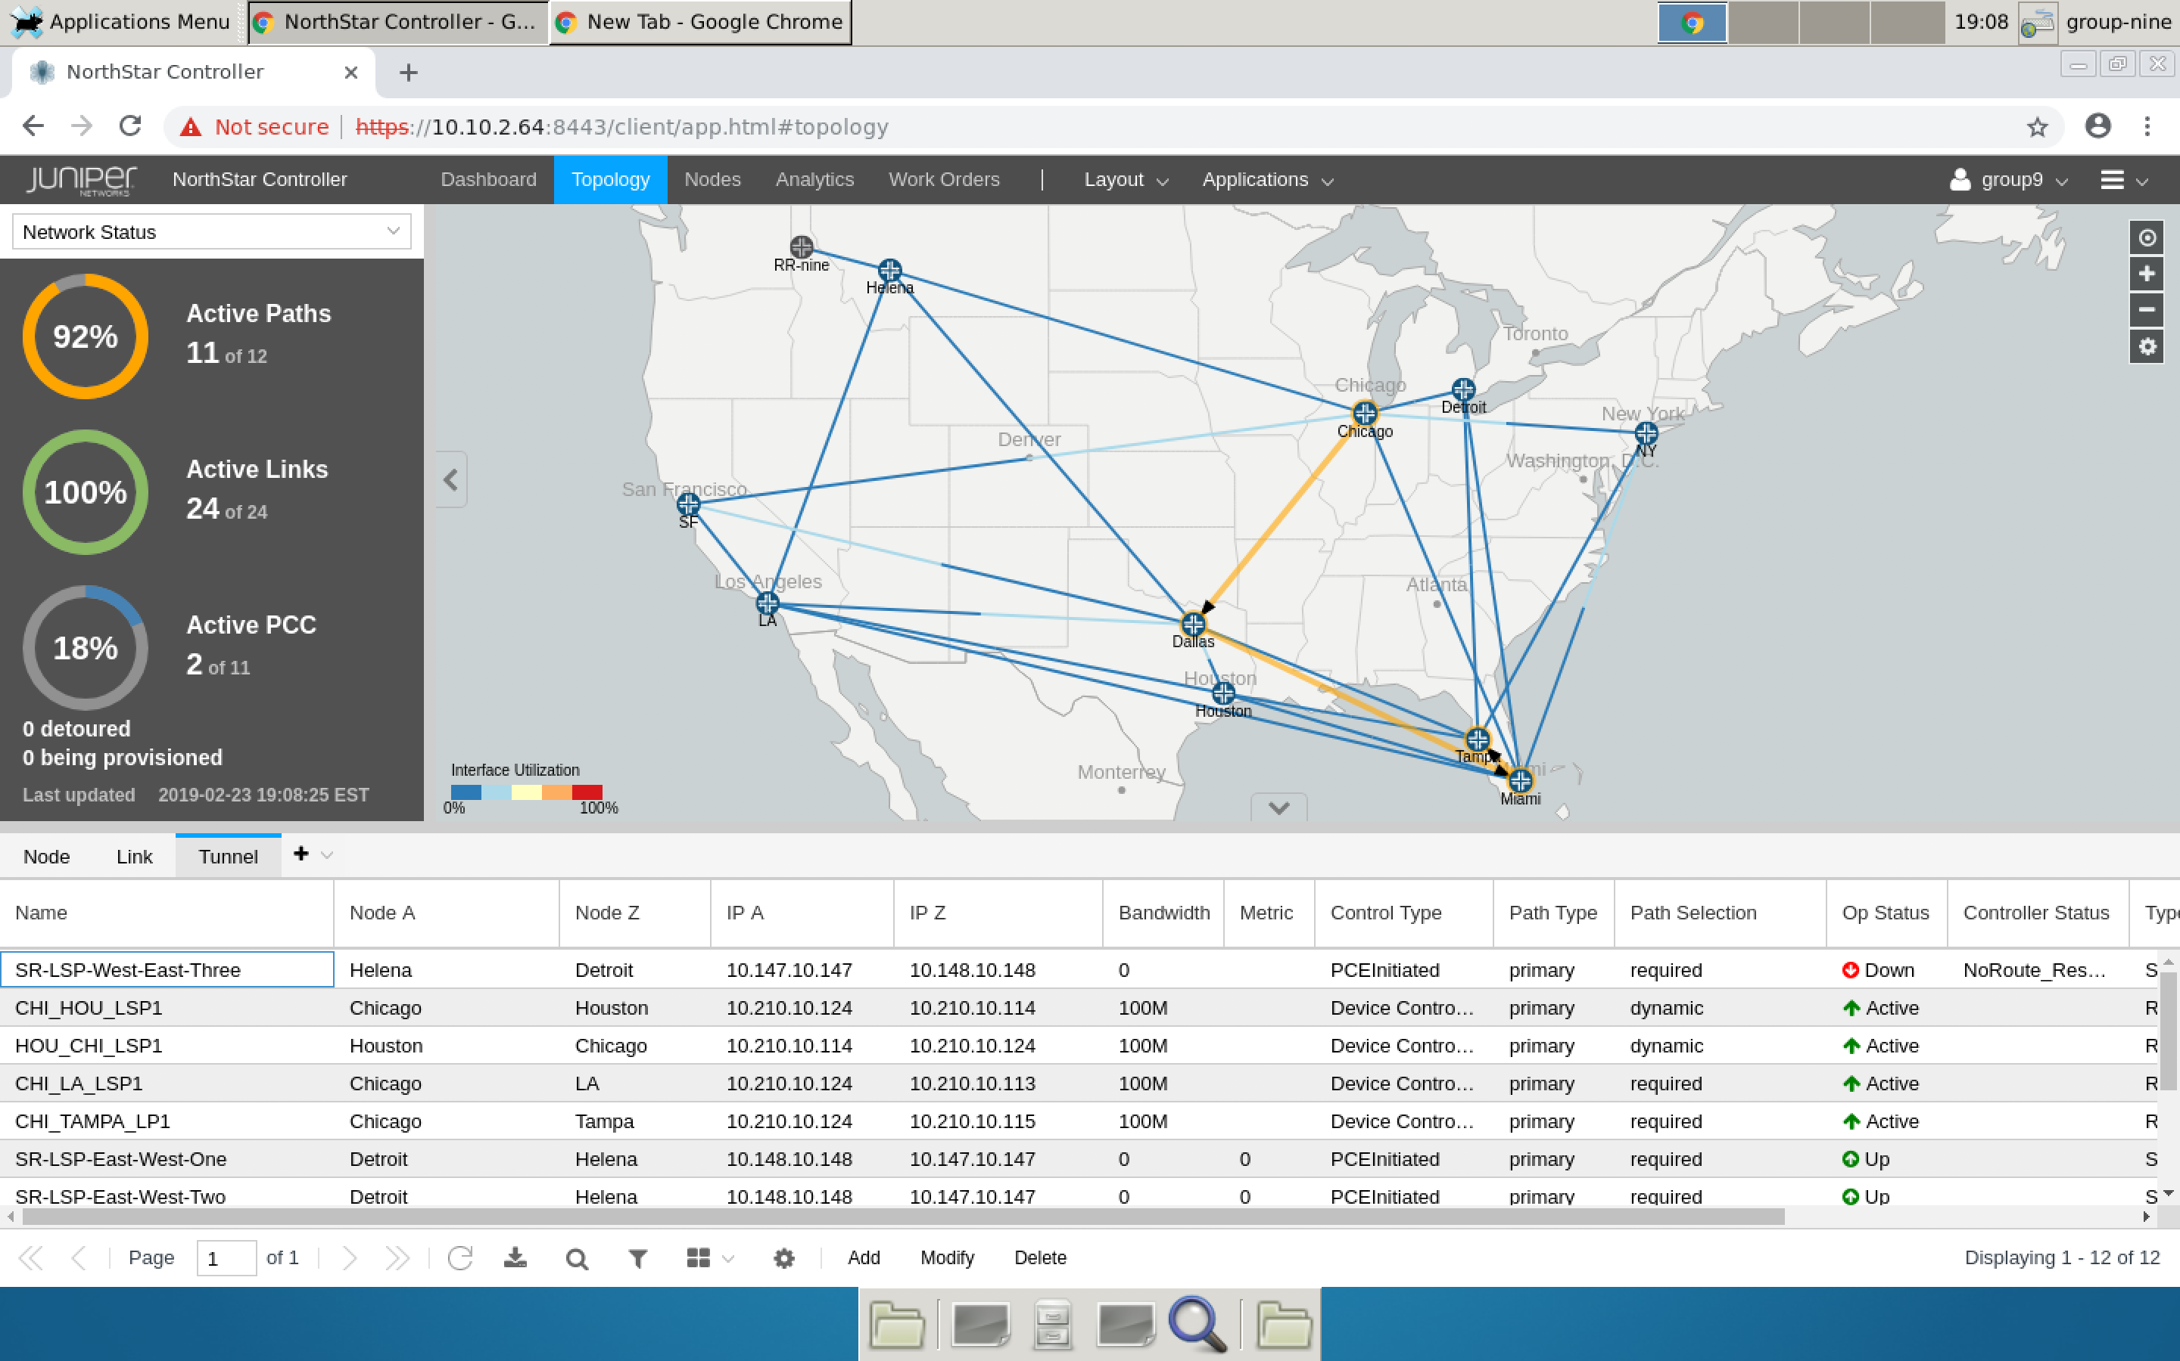

Slide 7




Tiered Paths
Government Relevant and Local Merchandising
Failover Using Rerouting
3rd Lowest Latency Link
Business Relevant Traffic
Failover Using Rerouting
2nd Lowest Latency Link
Business Critical and Instant Applications
Failover Using Rerouting
Lowest Latency Link
Redundant LSP

Slide 8


Optimized Links & Redundant Paths
Select the lowest latency path instead of the shortest distance path
Longer distance Path with the lowest latency
2ms latency
2ms latency
The Shortest distance path needs more latency
6ms latency

Slide 9
Demo time
1. When link fails
2. When traffic is over threshold
Notes:
咱们有了post，可以模拟一下link failure （输入错误IP）。
咱们研究一下generate traffic和这个redunency设置问题。
最理想的是，比赛时demo link failure，系统自动reroute。 比赛时demo traffic，系统自动reroute

Slide 10
Future Enhancements
Addition of Link Utilization into Path Calculation
Add historical link utilization into the LSP determination algorithm
Path Latency Threshold Parameters
User be able to set a Latency Threshold per LSP category
If LSP Latency exceeds threshold re-optimize the topology
Historical Optimization Statistics
Store in a DB the Optimization events and path statistics
Notes:
成博TODO：
ML能帮啥忙？说说就行了。比如说根据统计，每到3月份的时候，波士顿的router就容易炸。我们系统会在2月底的时候，take 波士顿
Traffic会很heavy into consideration.
或者说NLP，3月份波士顿的router容易炸，我去抓3月份发生了什么事，人们搜了什么关键词再google上。以后只要在某个地区，人们搜这个关键词（超级杯导致的traffic）。我就系统alert，自动选出第二优的线路。随时待命

Slide 11

Questions & Answers
TODO
2019 Juniper & Comcast
Notes:
Jialu Sun

